Slide 1
B: Introduction to TMB
Day 1: 09h00-11h00
Notes:
a

Slide 2
Specifying the Problem
TMB programs are written using a template (stored in a CPP file).
The CPP file specifies:
  the function to be minimized ;
  the parameters that are to be varied to minimize the function;
  any variables that depend on the parameters, but are not parameters themselves; and
  the data (constants) that are part of the function.
The function is minimized from R.

Slide 3
The TMB “Approach”
Read in the data
Create R lists that specify the data and the parameters.
Create a .CPP file. This file provides the specifications to:
  identify the parameters and any derived variables;
  define the model; and
  define the objective function to be minimized.
Compile and link the resultant C++ program as you would any other C++ program (done through R).
Link the compiled CPP code
Run the analysis and analyze the results.

Slide 4
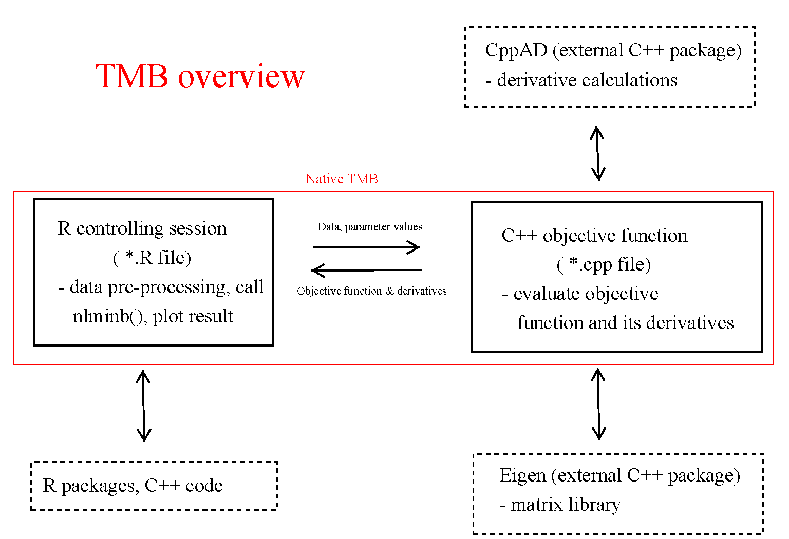
Taken from https://github.com/James-Thorson/2016_Spatio-temporal_models

Slide 5
The R link into things
setwd(“D:\\.....\\")
data <- list(x=rivers)
parameters <- list(mu=0,logSigma=0)
require(TMB)
compile(‘LectB1.cpp')
dyn.load(dynlib(‘LectB1'))
model <- MakeADFun(data,parameters)
fit <- nlminb(model$par, model$fn, model$gr)
rep <- sdreport(model)
List of Data
List of Estimated
Parameters
Create a DLL
Standard call to
nlminb
This code can be found in “LectB1.R”

Slide 6
Overview of the Process
Write the model and likelihood in XX.CPP
Define the data inputs as a list and the parameters as a list
Compile the cpp file.
Construction a model object using “MakeADFun”
Minimize the function (e.g. using nlminb)
Look at the results.

Slide 7
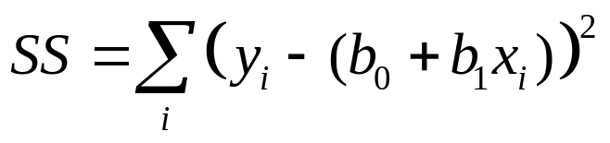
The First Real Example - I
We start with a least-squares problem:
  Find a and b by minimizing:
Program: LECTB2.CPP and LECTB2.R
Data File: LECTB2.DAT
Have a look at the various files

Slide 8
The First Real Example - II
R code
data <- read.table("LectB2.dat", header=TRUE)
parameters <- list(b0=0, b1=0, logSigma=0)
require(TMB)
compile("LectB2.cpp")
dyn.load(dynlib("LectB2"))
model <- MakeADFun(data, parameters, DLL="LectB2",silent=T)
fit <- nlminb(model$par, model$fn, model$gr)
best <- model$env$last.par.best
rep <- sdreport(model)
print(best)
print(rep)
Specify parameters
Compile and load
Create a model object
Fit the model and extract output
Note the file names are case-sensitive

Slide 9
The First Real Example - III
#include <TMB.hpp>
template<class Type>
Type objective_function<Type>::operator() ()
{
DATA_VECTOR(x);
DATA_VECTOR(y);
int n = y.size();
PARAMETER(b0);
PARAMETER(b1);
PARAMETER(logSigma);
vector<Type> yfit(n);
Type neglogL = 0.0;
yfit = b0 + b1*x;
neglogL = -sum(dnorm(y, yfit, exp(logSigma), true));
return neglogL;
}
Specify data
Specify parameters
Temp storage
Negative log-likelihood

Slide 10
Dissecting The Program
(arithmetic)
yfit = b0 + b1*x;
neglogL = -sum(dnorm(y, yfit, exp(logSigma), true));
The first line is a vector operation - it defines a vector, each element of which, yfit(i), is b0+b1*x(i).
The second line sums the likelihood (assumed to be normal) of the observed (y) data given the predicted (yfit) values – this is also a vector operation and follows the R formal.

Slide 11
Understanding MakeADFun
data: the data to be passed to the function (as a list)
parameters: a list of estimable parameters (including random and fixed effects)
map: provides a way to fix parameters (not estimate, or make parameters equal)
random: which variables are random
DLL: name of the DLL

Slide 12
Two phases (and map)
NA here means fixed
## Phase 1
map <- list(u=factor(rep(NA,data$nG)),log_sigma=factor(NA))
obj <- MakeADFun(data,parameters,map=map,DLL="nmix")
opt <- nlminb(obj$par,obj$fn,obj$gr)
pl <- obj$env$parList(opt$par) ## Parameter estimate after phase 1
## Phase 2
obj <- MakeADFun(data,pl,random="u",DLL="nmix")
opt <- nlminb(obj$par,obj$fn,obj$gr)

Slide 13
More on map
Lets say you have an vector beta and you want the 2nd and 4th elements to be same. You can achieve this using:
map(beta=factor(c(1,2,3,2)))

Slide 14
Sdreport
By definition, TMB will return asymptotic variances for the parameters. These can be viewed using sdreport(obj).
To compute standard errors for derived quantities, you need to define an ADREPORT variable.
Type gamma = alpha*alpha;
ADREPORT(gamma);

Slide 15
Getting variance information
To extract the Hessian matrix
model$he()
To extract the variance-covariance matrix for “model”:
solve(model$he())
To extract the correlation matrix for “model”
cov2cor(solve(model$he()))
To extract the standard errors for “model”
sqrt(diag(solve(model$he()))))

Slide 16
Reporting-I
To simply report results back to R (no variances), use
REPORT.
Type delta = alpha*alpha*alpha;
REPORT(delta);
To access the results being reported back to R use:
obj$report();

Slide 17
Reporting-II
To access the parameter estimates (fixed and random) use:
rep <- sdreport(obj)
summary(rep,select=“fixed”)
summary(rep,select=“random”)
xx <- summary(rep)
Use <- row.names(xx) == "SSB"
SSB <- xx[Use,]

Slide 18
Reporting-III
To report results back to R (with variances), use
ADREPORT.
REPORT(CW);
REPORT(N);
REPORT(S);
REPORT(SigmaR);
REPORT(Paa);
ADREPORT(FullF);

Slide 19
Something About Arithmetic
The following are the TMB arithmetic expressions:
  Z=a+b – addition (note Z+=b)
  Z=a-b – subtraction
  Z=a*b – multiplication
  Z=a/b – division
TMB implements all the standard functions (and more):
  Z=log(a)
  Z=exp(a)
  Z=square(a)

Slide 20
Declaring Variables
Before a variable is used, it has to be declared.
Key distinction among variables:
  Data that are passed from R (declared in the form DATA_XX(var_name) ).
  The parameters to be estimated (declared in the form PARAMETER(var_name) ). Note NO integer parameters!
  Temporary variables (declared in the form “Type xx”)
Notes:
Not at the local level
CITES listings

Slide 21
Data Types
TMB needs to know what dimensions and format your data/variables/parameters will be in!
The most-basic types:
  DATA_INTEGER (e.g. int Count) – integer.
  DATA_IVECTOR – vector of integers.
  DATA_IMATRIX – matrix of integers.
  DATA_IARRAY – array of integers.
  DATA_SCALAR (e.g. number) – real.
  DATA_VECTOR – vector of reals.
  DATA_MATRIX – matrix of reals.
  DATA_ARRAY – array of reals.
  DATA_STRUC – A structure.
  DATA_STRING – A string.
All variables MUST be declared before they are used – no exemptions!

Slide 22
Parameter Types
TMB needs to know what dimensions and format your data/variables/parameters will be in!
The most-basic types:
  PARAMETER - real
  PARAMETER_VECTOR – vector of real
  PARAMETER_MATRIX – matrix of real

Slide 23
Local variables
Type p; [scalar]
vector<Type> q(5); [vector]
matrix<Type> z(5,5); [matrix]
array<Type>k(5,5,5); [array]
int I; [integer]
vector<int>jj(5); [integer vector]

Slide 24
Structures
If you have a bunch of data elements they can packaged into a structure:
template <class Type>
struct dataSet{
int Nyear;
vector<int> Nlen;
matrix <int> SelSpec;
vector <int> Fleet_area;
matrix <type> Area_fleet;
array <Type> SelPnt;
array <int> RetPnt;
};
Structures can be passed in functions
Setting up the element of a structure
dataSet<Type> dataset;
DATA_INTEGER(Nyear); thedata.Nyear = Nyear;

Slide 25
Variable Names-I
Variable names:
  Must start with an alphabetic character.
  Don’t use any reserved words (if, else, etc.)
  Choose descriptive, but not overly long, variable names (e.g. biomass, MSY).
  TMB is case-sensitive, i.e. the variables biomass and Biomass are NOT the same variable.

Slide 26
Variable Names - II
Other rules / hints:
  Use underscores to split names within a variable name (e.g. my_biomass).
  Avoid re-using the same variable for different purposes.
  Don’t forget those semi-colons!
  All arrays start at 0 (this is C), which can be confusing for R users.

Slide 27
Getting more information
When I get stuck (yes it happens). I go to online resources:
The TMB documentation within R
Kaspars documentation: https://kaskr.github.io/adcomp/index.html
“The Book” http://kaskr.github.io/adcomp/_book/Introduction.html

